Slide 1
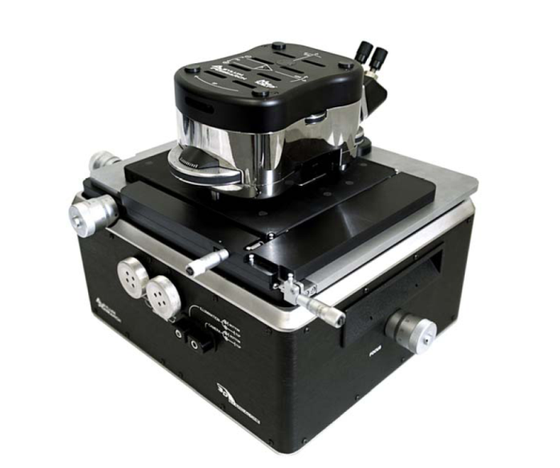
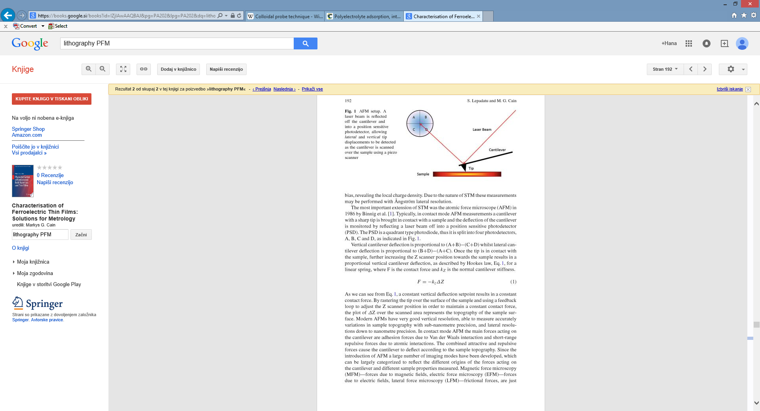
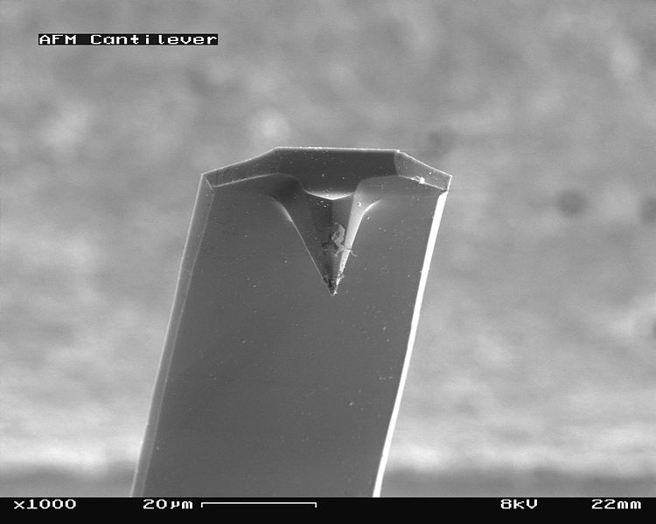
Atomic force microscopy (AFM)
AFM HEAD
Laser beam
SLIDING RACK
(X,Y)
Cantilever
Tip
Sample
Asylum MFP-3D AFM
MODES:
AFM (contact, tapping)
Piezo-response force microscopy (PFM)
Conductive AFM (CAFM)
Kelvin-probe force microscopy (KPFM)
Electrostatic-force microscopy (EFM)
Magnetic force microscopy (MFM)
Scanning thermal microscopy (SThM)-NEW
TIP
CANTILEVER
Asylum Research MFP-3D Users Manual
http://en.wikipedia.org/wiki/Atomic_force_microscopy
M. Cain, Springer, Characterization of ferroelectric bulk materials and thin films

Slide 2
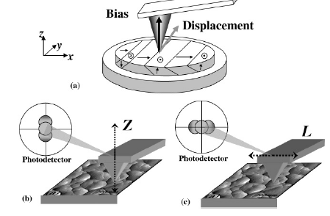
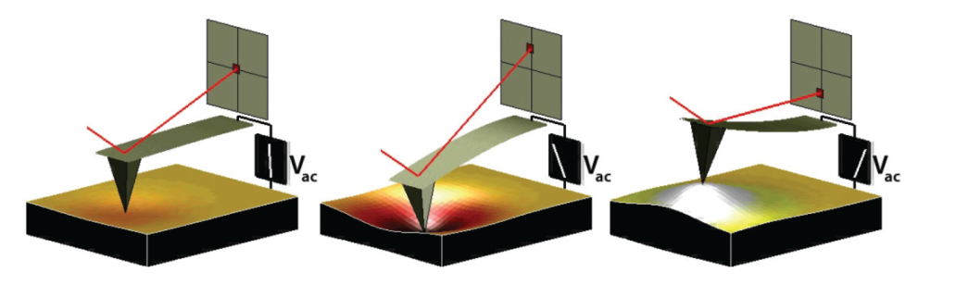
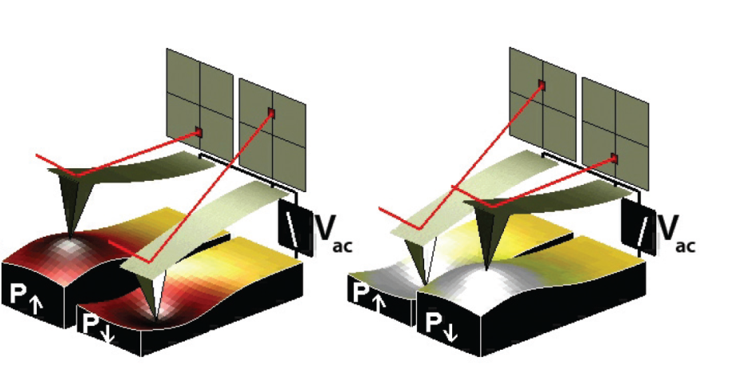
Piezo-response force microscopy (PFM)
the voltage applied to the scanning tip in contact mode
conductive tip: (usually Si tip on Si cantilever, coated with Ti/Ir or Pt)
tip diameter: 7 nm to 30 nm
VERTICAL AND LATERAL DIRECTIONS
Driving signal: V = Vac cos(ωt)
Kalinin et al., Microsc. Microanal. 12, 2006.
http://www.ntmdt.com
Piezoresponse Force Microscopy with Asylum Research AFMs, S. Jesse, ORNL
PROKSCH, R. in KALININ, S. Piezoresponse Force Microscopy with Asylum Research AFMs, Users Manual.

Slide 3
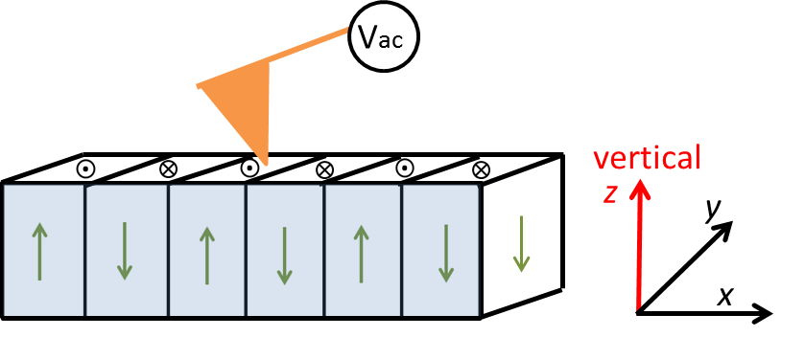
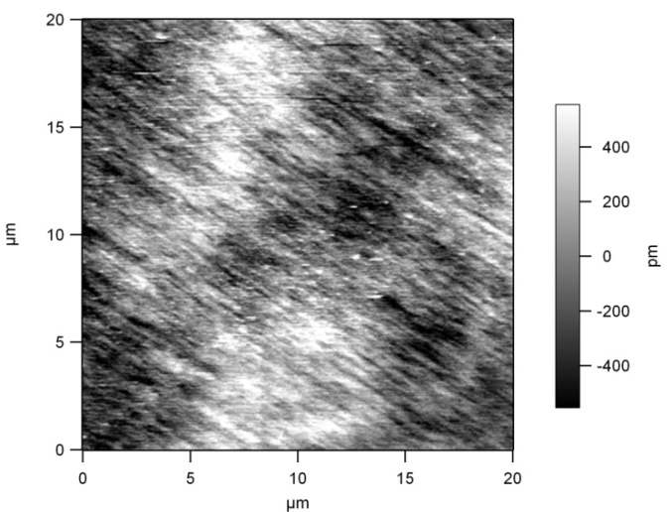
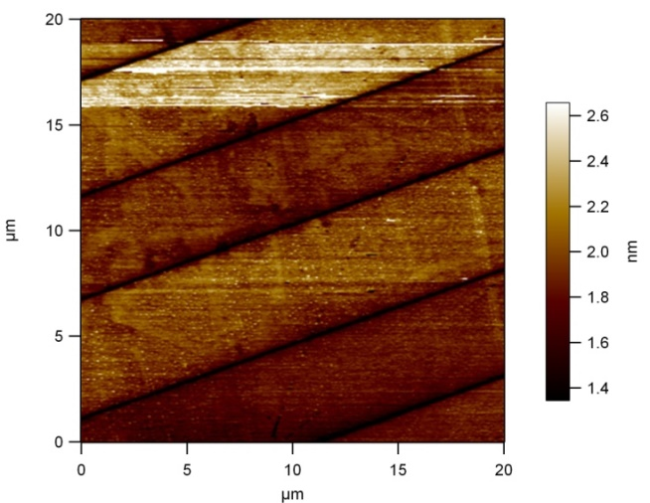
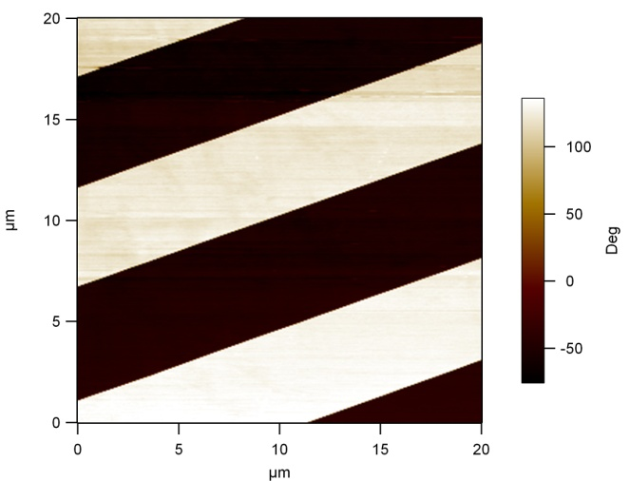
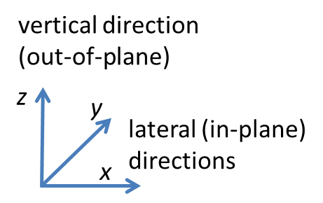
A) Vertical PFM mode-example
Periodically poled lithium niobate
Topography
PFM vertical amplitude image
PFM vertical phase image
5 μm
domain boundaries
no response (black line)

Slide 4
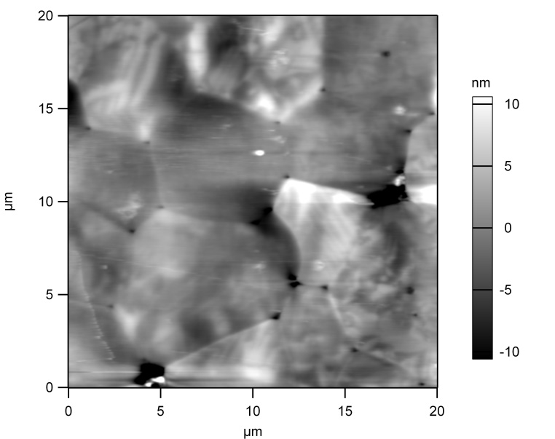
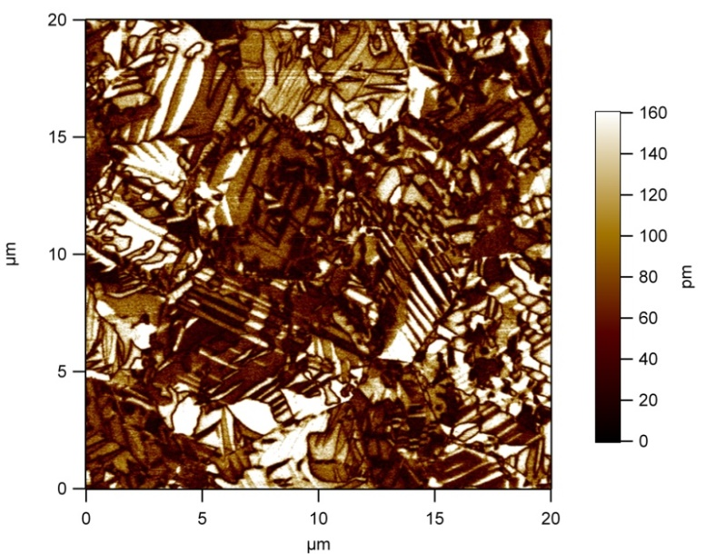
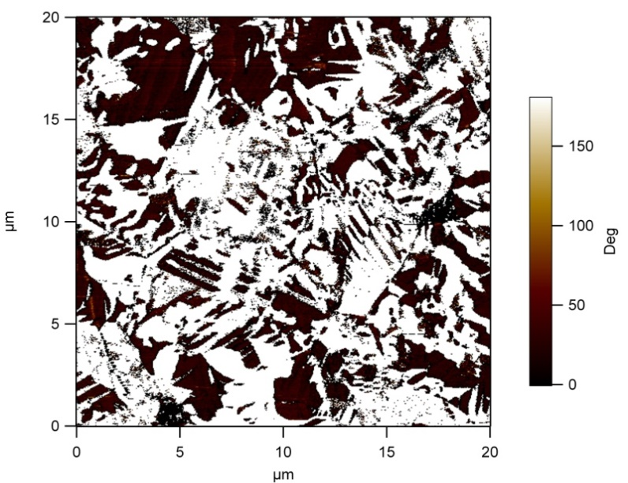
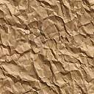
A) Vertical PFM mode-example
Pb(Sc_{0.5}Nb_{0.5})O₃ ceramics
vertical
Topography
PFM vertical amplitude image
PFM vertical phase image
height
25
20
15
nm
10
5
5 μm
0

Slide 5
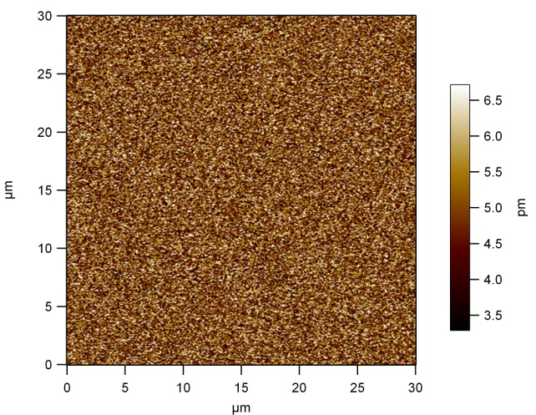
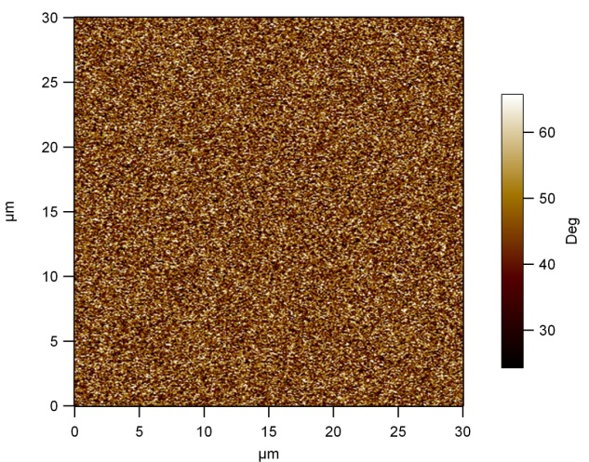
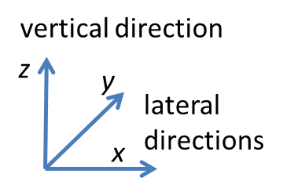
C) Vector PFM mode (vertical and lateral directions)
Periodically poled lithium niobate
Topography
PFM vertical amplitude image
PFM vertical phase image
5 μm
PFM lateral amplitude
image
PFM lateral phase
image
no signal in lateral direction

Slide 6
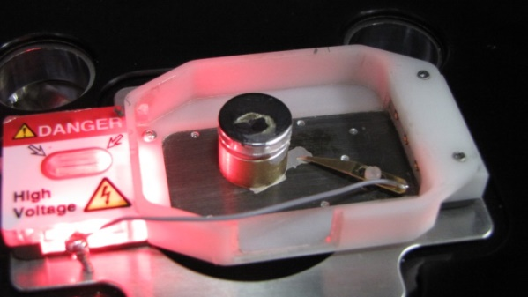
C) Vector PFM mode (vertical and lateral directions)
BiFeO₃ ceramics
VERTICAL Z
LATERAL Y
by rotating the ceramic sample
for 90°
LATERAL X
T. Rojac, H. Uršič et al., Adv. Fun. Mat. 2015

